Slide 1
Personalised medicine &
clinical practice guidelines
Jako Burgers

Slide 2
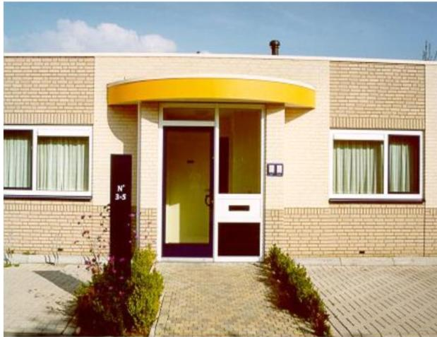
Disclosure
General Practitioner, Gorinchem, Netherlands
Senior Consultant, Dutch College of General Practitioners (NHG)
Academic Chair ‘Promoting Personalised Care in Clinical Practice Guidelines’, Care and Public Health Research Institute (CAPHRI), Maastricht University
Founding member of G-I-N

Slide 3
Three questions
What’s new in personalised medicine?
Is personalised medicine compatible with (generic) clinical practice guidelines?
How can the guideline community contribute to personalised care?

Slide 4
Outline of presentation
What’s new in personalised medicine?
Is personalised medicine compatible with (generic) clinical practice guidelines?
How can the guideline community contribute to personalised care?

Slide 5
What is personalised medicine?
‘a medical model that separates people into different groups—with medical decisions, practices, interventions and/or products being tailored to the individual patient based on their predicted response or risk of disease’
Academy of Medical Sciences. May 2015.

Slide 6
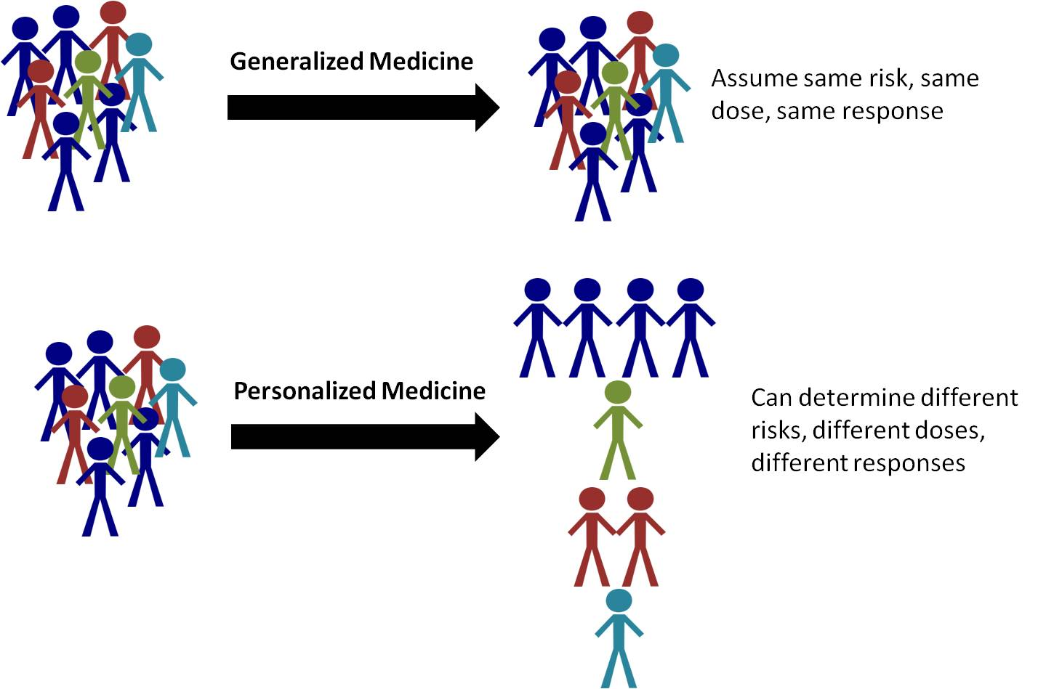
Generalised versus personalised medicine

Slide 7
Alternative terms
Stratified medicine – Matching therapies with specific patient (sub)population characteristics using clinical biomarkers (e.g. age group, disease stage) Trusheim et al. Nat Rev Drug Discov. 2007
Precision medicine – Integration of molecular research (e.g. genomics) with clinical data from individual patients to develop a more accurate taxonomy of diseases that enhances diagnosis and treatment and tailors disease management to the individual characteristics of each patient US National Academy of Sciences report, 2011

Slide 8
From ‘One-size-fits-all’ to Precision Medicine
Source: Frost & Sullivan - Figure 1: New Paradigm Shift in Treatment.

Slide 9
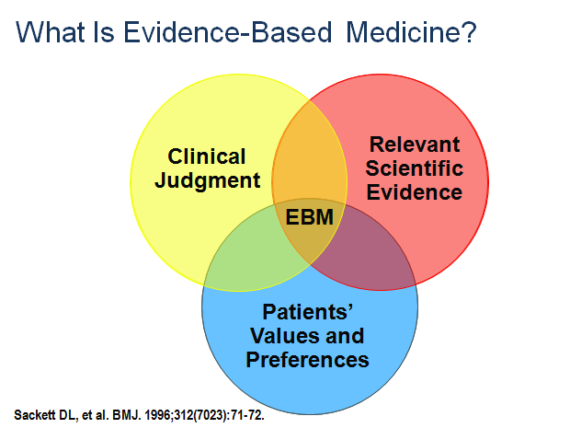
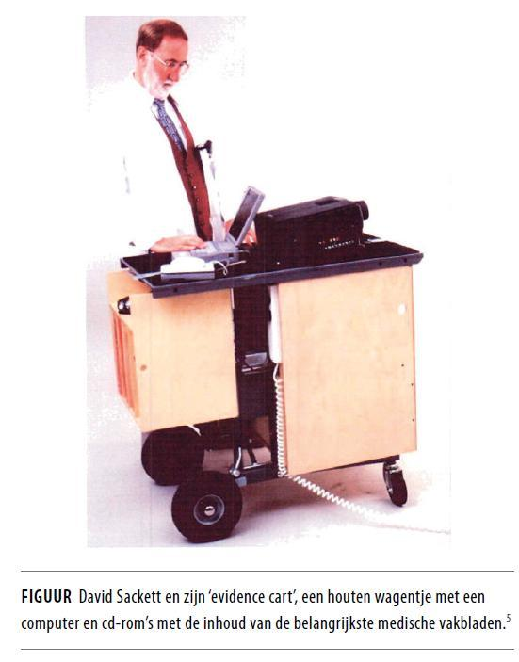
A déjà vu
‘The conscientious, explicit, and judicious use of current best evidence in making decisions about the care of individual patients’

Slide 10
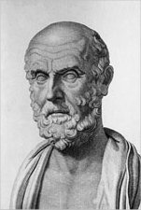
Our guru of personalised medicine
‘It is more important to know what sort of person has a disease, than to know what sort of disease a person has’
Hippocrates (c. 460 – c. 370 BC)

Slide 11
What’s new in personalised medicine?
Use of molecular taxonomy of diseases and genetic profile in clinical decision making
Increasing role of patients and public in adoption of new medical approaches

Slide 12
Outline of presentation
What’s new in personalised medicine?
Is personalised medicine compatible with (generic) clinical practice guidelines?
How can the guideline community contribute to personalised care?

Slide 13
From EBM to clinical practice guidelines
Scientific
literature
(‘evidence’)
Professional expertise
Clinical practice
guidelines
Patients
experience

Slide 14
From EBM to guideline movement
Search term guideline* limited to title and year

Slide 15
Change in definition of guidelines
Clinical practice guidelines are statements that include recommendations intended to optimize patient care that are informed by a systematic review of evidence and an assessment of the benefits and harms of alternative care options.
Institute of Medicine, 2012
Clinical practice guidelines are systematically developed statements to assist practitioner and patient decisions about appropriate health care for specific clinical circumstances.
Institute of Medicine, 1990

Slide 16
Problems with developing guidelines
Keeping increasing volume of guidelines up-to-date
Increasing complexity of methodology – do we need Magic to use GRADE?
Integrating the patient’s perspective
Addressing multimorbidity

Slide 17
Intermezzo – a piece of algebra
Suppose you have 10 chronic conditions,
the number of combinations with:
2 conditions = 45
3 conditions = 120
4 conditions = 210
5 conditions = 252
Etc…
‘Mission impossible for guideline developers’

Slide 18
Why to continu developing guidelines?
To reduce undesired practice variation
To digest the exponential grow of publications in medicine
To formulate unbiased recommendations for clinical practice
To transparantly present the state of the art to stakeholders in health care

Slide 19
Is personalised medicine compatible with clinical practice guidelines?
Yes, it is!
Clinical questions in guidelines can be answered more precisely (e.g. effectiveness of drugs using genetic profile)
Critical appraisal includes assessing differences between patient subgroups
Patient views and preferences are considered in translating the evidence to recommendations

Slide 20
Outline of presentation
What’s new in personalised medicine?
Is personalised medicine compatible with (generic) clinical practice guidelines?
How can the guideline community contribute to personalised care?

Slide 21
From personalised medicine to personalised care
Personalised medicine is the biomedical basis of patient centered healthcare based on individual genetic and biological data.
Personalised care is the application of patient centered healthcare in clinical practice in which 'hard core data' are integrated with individual patient values and preferences.

Slide 22
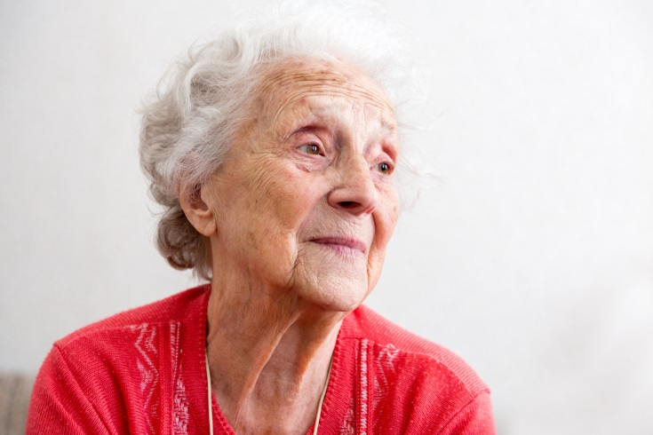
Case in general practice
Multiple conditions: hypertension, nocturnal restless legs, osteoporosis, renal dysfunction, thyroid disease
Daily use of 8 different drugs
Lives independently in senior appartment
Good contact with children and grandchildren in neighborhood
2010: stroke with left-sided paraesthesias and strongly rising blood pressure
Mrs Schol, age 84

Slide 23
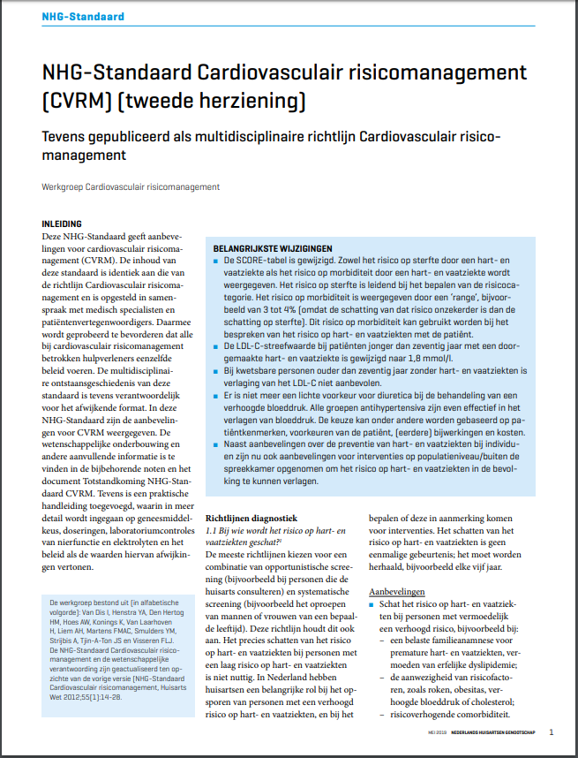
Case in general practice
Guideline Cardiovascular risk management
Mrs Schol, age 84

Slide 24
Problems with applying the guideline
Difficult to reach target values (SBP < 140 mmHg, LDL < 1.8 mmol/l)
Use of targets as quality measure in disease management programs
Burden of treatment due to polypharmacy

Slide 25
From guidelines to personalised care
Scientific
literature
(‘evidence’)
Aggregated
professional expertise
Individual professional expertise
Clinical
practice
guidelines
Clinical practice
guidelines
Personalised care
Aggregated patient
experience
Individual patient
experience
Health system (macro) level
Clinical practice (micro) level

Slide 26
Strengthening patients role: Ask 3 Questions
What are my options?
What are the possible benefits and risks of those options?
How likely are the possible benefits and risks of each option to occur?
Shepherd H, et al. Education and Counseling. 2011.
In case of multimorbidity: define individual goals and prioritise

Slide 27
Case in general practice – epilogue
Consultation nefrologist
‘Patient always gets side effects with new antihypertensive drugs. That is why we decided to keep it with enalapril and no longer measure blood pressure ’
Mrs. Schol, one week later
‘I am so happy that my blood pressure no longer needs to be measured. I now feel much more relaxed’
‘I prefer a higher risk of dying rather than feeling bad from additional medication’
Mrs Schol, age 84

Slide 28
How can the guideline community contribute to personalised care?
Involve patients in defining health questions, patient outcomes, and formulating the recommendations
Consider evidence from personalised medicine research
Promote shared decision making by providing decision aids
Provide a disclaimer with the guidelines
Example: Guidelines are not intended to replace clinical judgement, but rather to complement it. The guidelines should be used to assist physicians to exercise their clinical judgement for the benefit of the individual patient based on the current best evidence.

Slide 29
Final thought
Guidelines do not define good care,
but health professional and patient do in practice!

Slide 30
Thank you!
Jako Burgers

