Slide 1


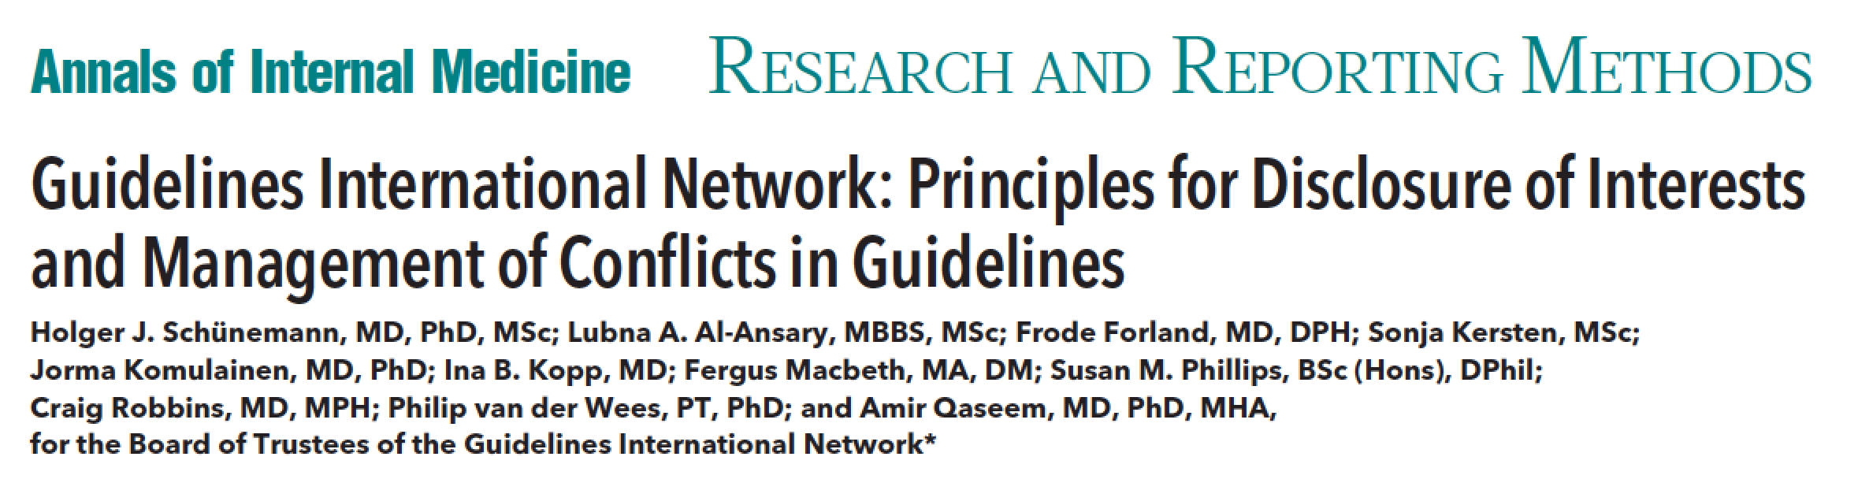
H⊕lger Schünemann, MD, PhD
Professor and Chair, Dept. of Clinical Epidemiology & Biostatistics
Professor of Medicine
Michael Gent Chair in Healthcare Research
McMaster University, Hamilton, Canada
@schunemann_mac

Slide 2


Disclosure
Co-chair
Various guideline and other committees
  Co-director, WHO collaborating center on evidence informed policy making
– Steering group
GIN – Board of Directors
No direct financial COI

Slide 3
Conflict of interest
“A divergence between an individual’s private interests and his or her professional obligations such that an independent observer might reasonably question whether the individual’s professional actions or decisions are motivated by personal gain, such as direct financial, academic advancement, clinical revenue streams, or community standing.”
Schünemann et al. Am J Respir Crit Care Med. 2009

Slide 4
Do financial interest lead to conflicts in guideline development?

Slide 5

BIAS
Dreamatico.com

Slide 6
Conflict of interest
Is a problem

Slide 7
Today’s presentation
GIN Conflict of interest disclosure and management principles

Slide 8
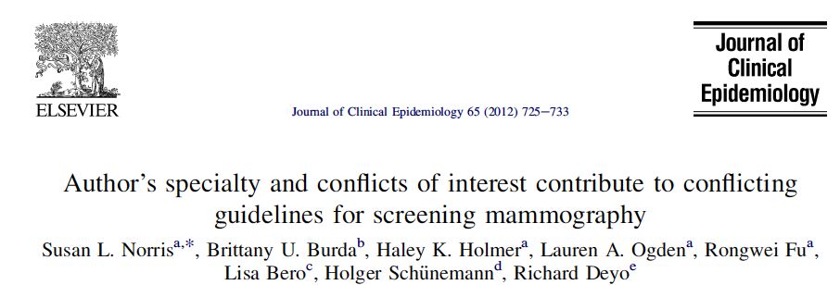
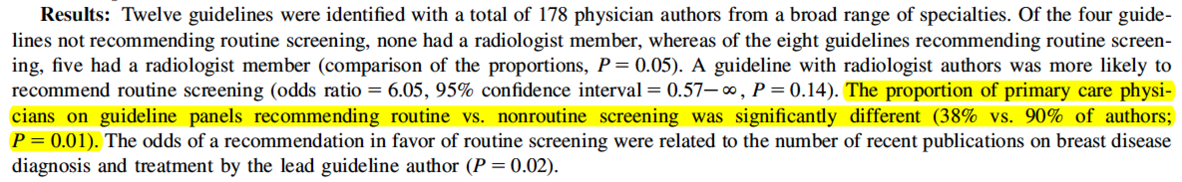

Slide 9
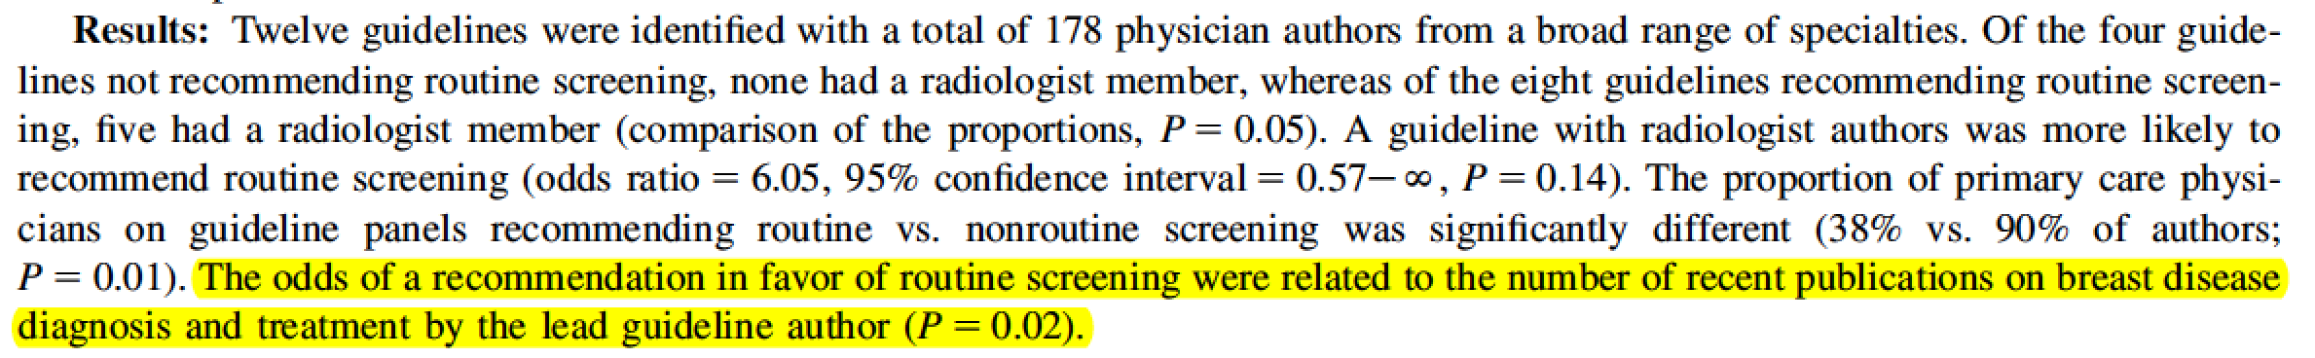

Slide 10
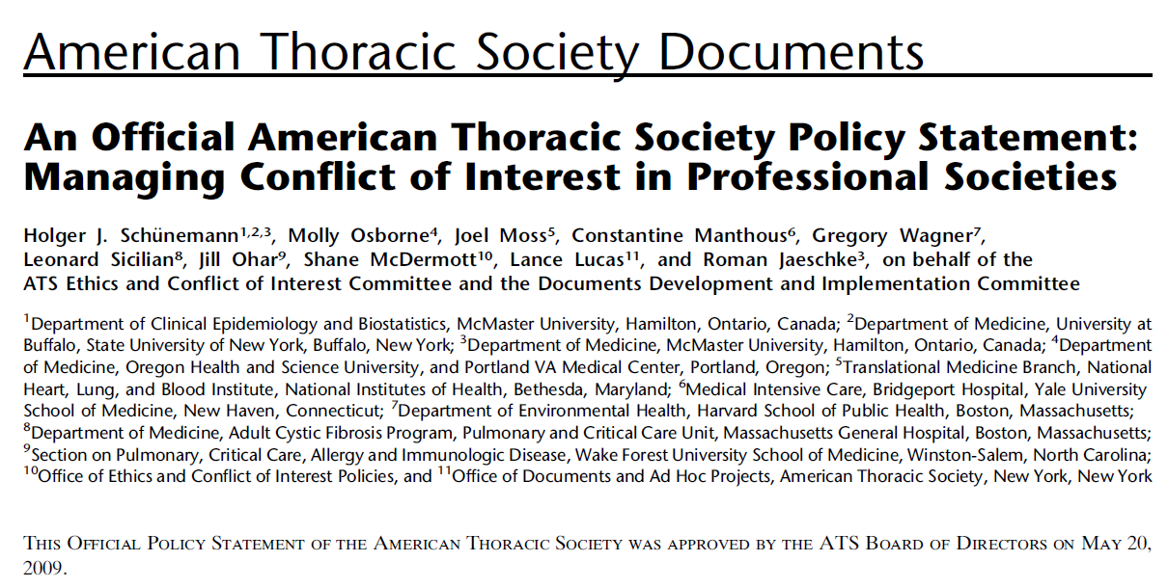

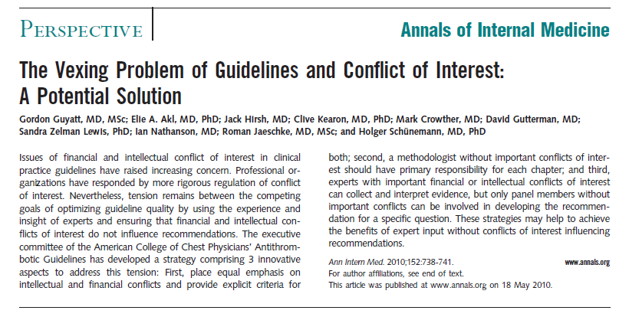

Slide 11
Methods for this GIN position paper
We declared our interests
Board of Trustees members
Reviewed policies of organizations and literature on COI disclosure and management
A few hundred emails
Teleconferences
X drafts and rounds of feedback
Consensus on principles

Slide 12
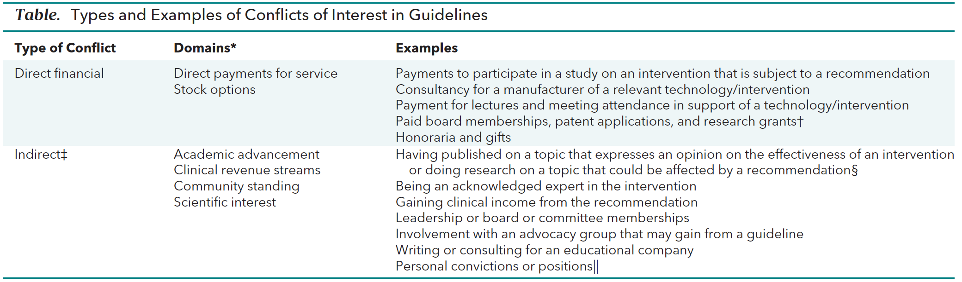

Slide 15
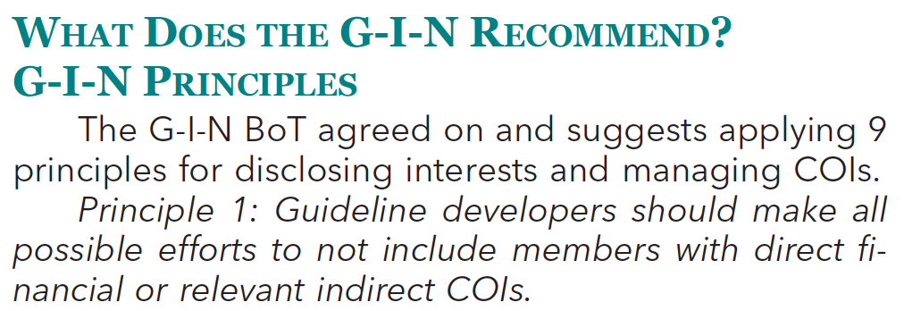
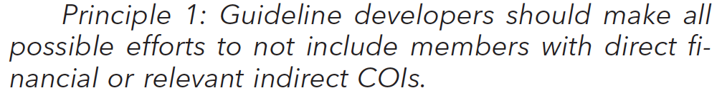
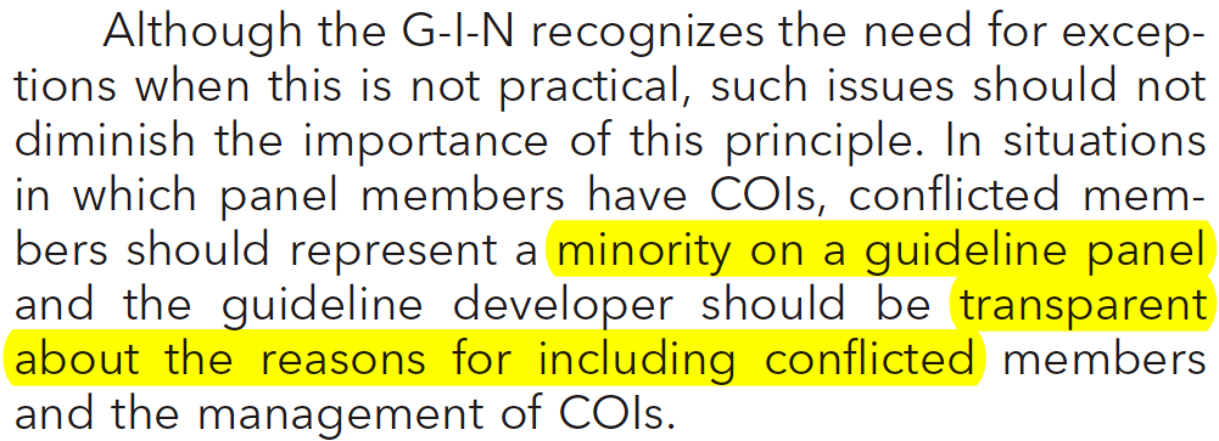

Slide 16
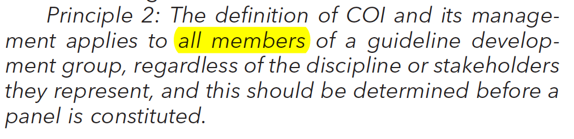

Slide 17
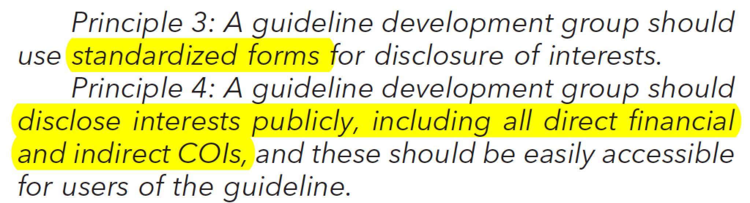

Slide 18
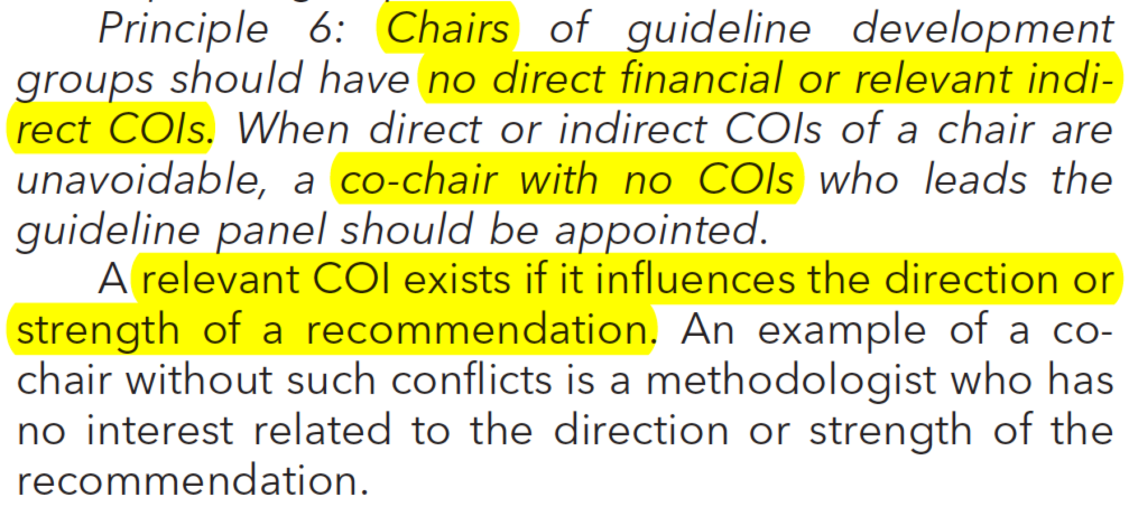

Slide 19
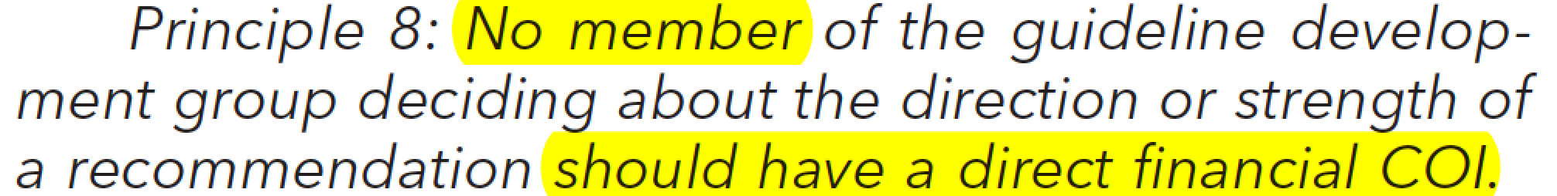

Slide 20
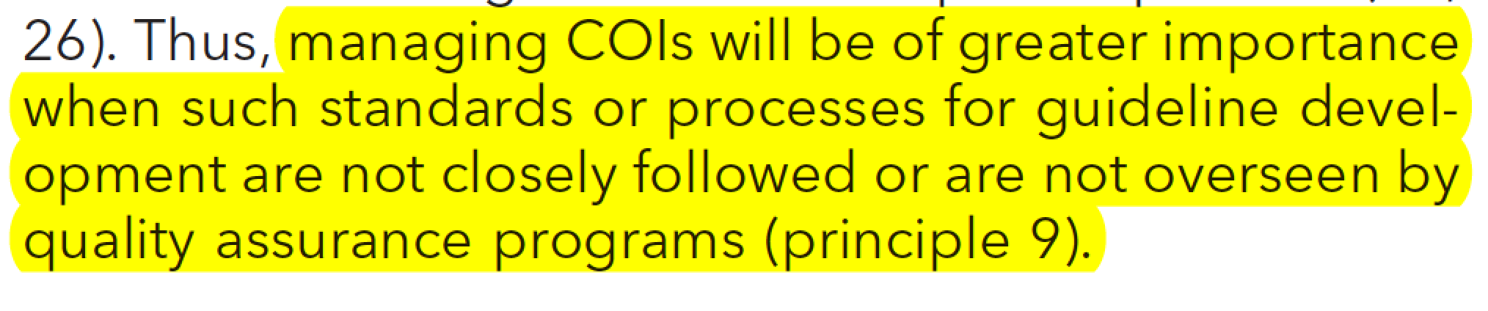
Stick to your methods!
Conflicts will be there!
Transparent methods and documentation of guideline development will be the best tool to protect against risk of bias
GIN-McMaster Guideline Development Checklist

Slide 21
Implementation Example:
American College of Physicians
Amir Qaseem MD, PhD, MHA, FACP
Director, American College of Physicians
Immediate Past President, Guidelines International Network

Slide 22
Disclosure of Interests
Financial: None
Non-financial/Intellectual/Indirect:
  Author on the GIN Disclosure/Management of Interests Paper
  Board of Trustees of G-I-N
  National Quality Forum (NQF)
  Centers for Disease Control and Prevention (CDC)
  Council of Medical Specialty Societies

Slide 23
Perception or Real COI?
New York Times – Nov 13, 2013 “Don’t give more patients statins”
“The group that wrote the recommendations was not sufficiently free of conflicts of interest; several of the experts on the panel have recent or current financial ties to drug makers.”
http://www.nytimes.com/2013/11/14/opinion/dont-give-more-patients-statins.html?_r=0
Issue is not that whether there was influence or not but perception lead to the red flag

Slide 24
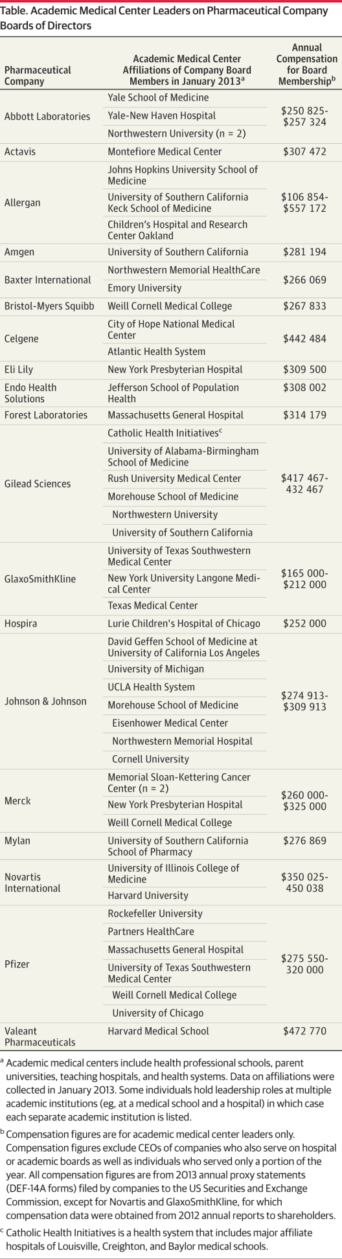
AMC Leaders on Pharma Boards
Anderson TS et al. Academic medical center leadership on pharmaceutical company boards of directors.
JAMA 2014; 311:1353-1355

Slide 25

IOM, COI,
and Pain
“100 million Americans suffer from severe chronic pain”
9 of 19 experts ties with pharma making narcotic painkillers
For example:
One individual, Stanford U SOM
Medical school received $3M unrestricted educational grant in Jan’10
Another individual, at Penn
2011 board member, Amer Soc Pain Medicine
Consultant to various companies
www.publicintegrity.org/news/Institute-of-Medicine
arthritis-control.com/iom-and-coi-painful-disclosures/

Slide 26
Basic Rules
Public disclosure of ALL interests (It is not disclosure of conflicts of interests or relevant interests)
Can only MANAGE conflicts. Can not RESOLVE conflicts.
No difference between PERCIEVED conflict and REAL/ACTUAL conflict

Slide 27
Categories of Interests (Individual and Close Personal Relations)
Financial
Intellectual
Direct
Indirect
Active
Inactive (past 3 years)
One year post guideline project completion

Slide 28
Categories of Interests (Individual and Close Personal Relations)
Low Level Conflict
Moderate Level Conflict
High Level Conflict

Slide 29
Low Level Conflict
(No Exclusion)
No direct financial
No indirect financial.
No direct intellectual
  Have not published a recommendation on a topic area.
  Worked on guidelines on different topic area
Action: Full participation

Slide 30
Moderate Level Conflict
(Partial Exclusion)
Direct financial
  individual receives grant from industry that
goes to employer on a topic area not related to a
guideline
  Individual receives funding from non-profit (e.g. AHRQ, NIH etc) on a topic area directly related to a guideline
Indirect financial
  Close personal relation received funding from pharma but not related to the guideline topic

Slide 31
Moderate Level Conflict
(Partial Exclusion)
Direct intellectual
  Individual has worked on the same guideline topic for another organization
Action: Participate in the discussion but not included in the panel or author or voting

Slide 32
High Level Conflict
(Complete Exclusion)
Direct financial
  Speakers bureau, stocks, boards
  Close personal relations receives or recently received money from pharmaceutical for a product directly related to the guideline
Action: Recused - no participation in any discussion or panel or author or voting

Slide 33

THANK YOU

Slide 34
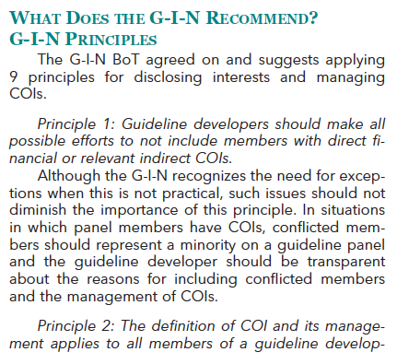

Slide 35
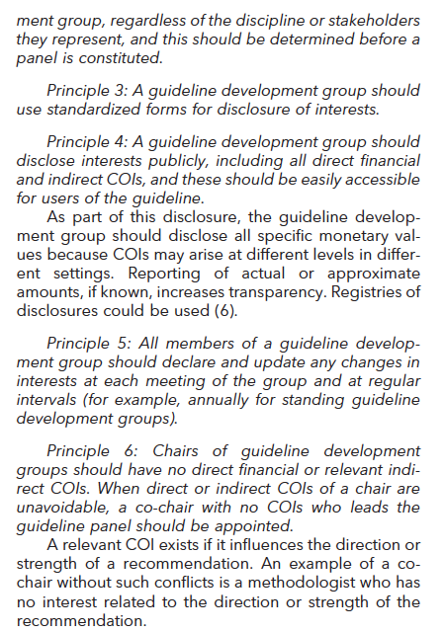

Slide 36
